Slide 1


Three Minute Thesis Competition
November, 6th, 2020

Slide 2
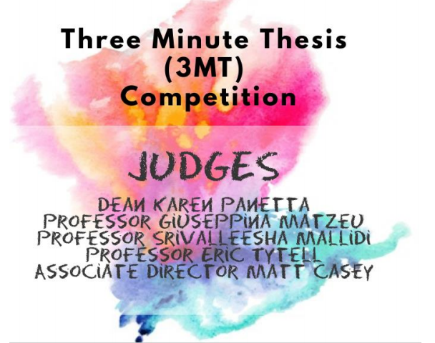

Slide 3

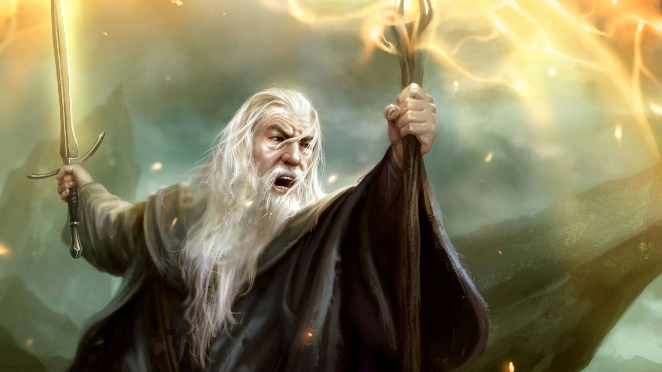
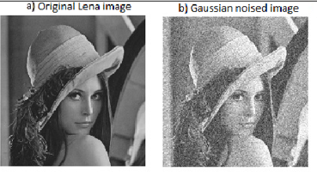

Slide 4
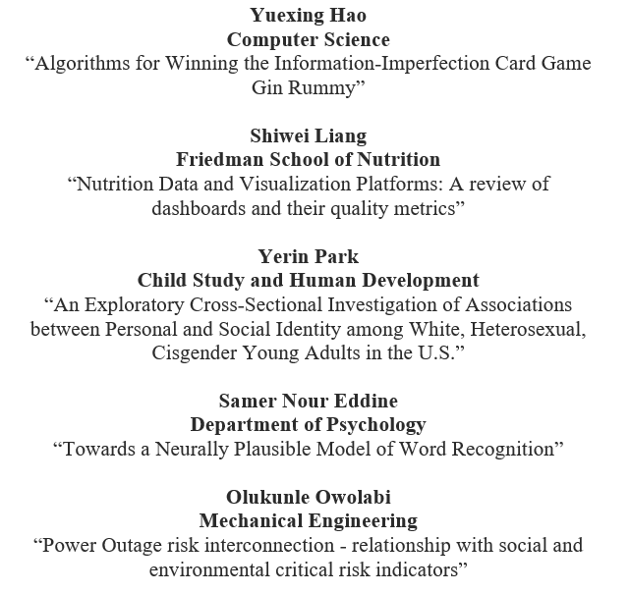
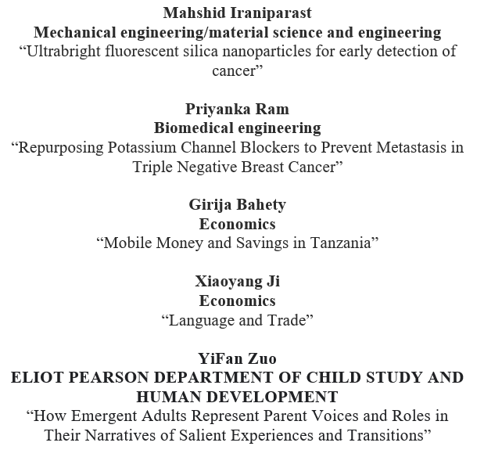

Slide 5
Tips for presenters
You have 3 minutes.
You will be judged from 3 perspective: Clarity, Conclusion, Logical Sequence.
After presentation, judges will go to the breakout room for discussion.
First through third place, plus an additional “People’s Choice” will be awarded.

Slide 6
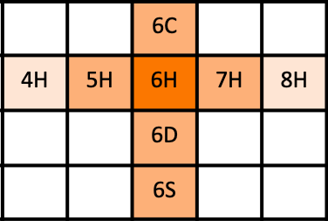
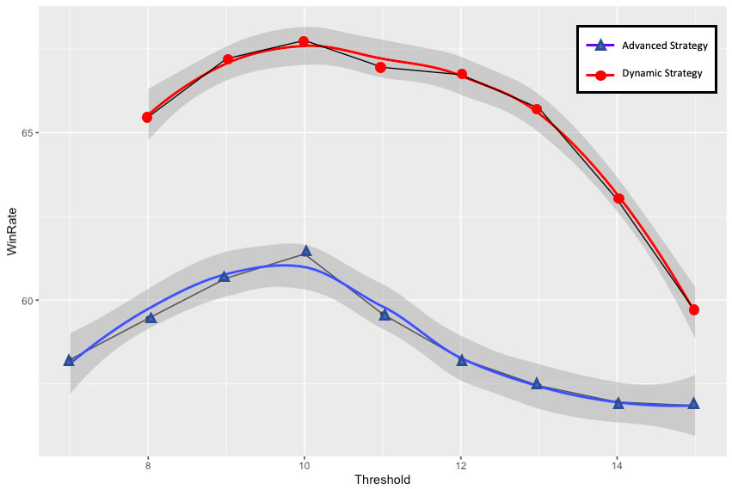
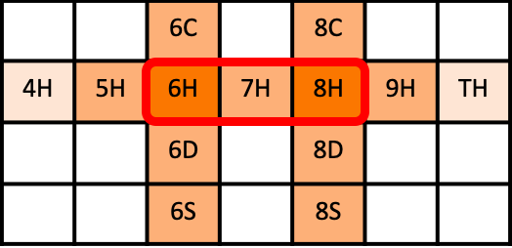
Algorithms for Winning the Information-Imperfection Card Game Gin Rummy
Yuexing Hao
Win Rate: 67.74%
Draw Strategy
Improve the possibility of choosing the right card
Decrease the risk of picking up a big dead deadwood card.
Win Rate: 57.85%
Discard Strategy
Dynamic Knock Strategy
Get rid of dead deadwoods
Lower total deadwood points
Know the potential melds around opponent’s discarding cards
Knock in a “smart” time based on opponent’s action
Win rate improves 10% significantly among 10,000 games
Opponent Hand Estimation Strategy
Analyze the face-up cards picked up by opponent
Estimate the melds opponent may have
Win Rate: 53.41%
Win Rate: ~50%
♦, ♥, ♣, ♠ | Diamond (D), Heart (H), Club (C), Spade (S)

Slide 7


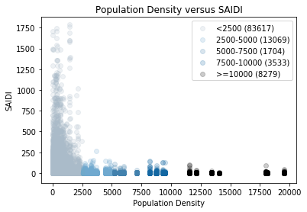
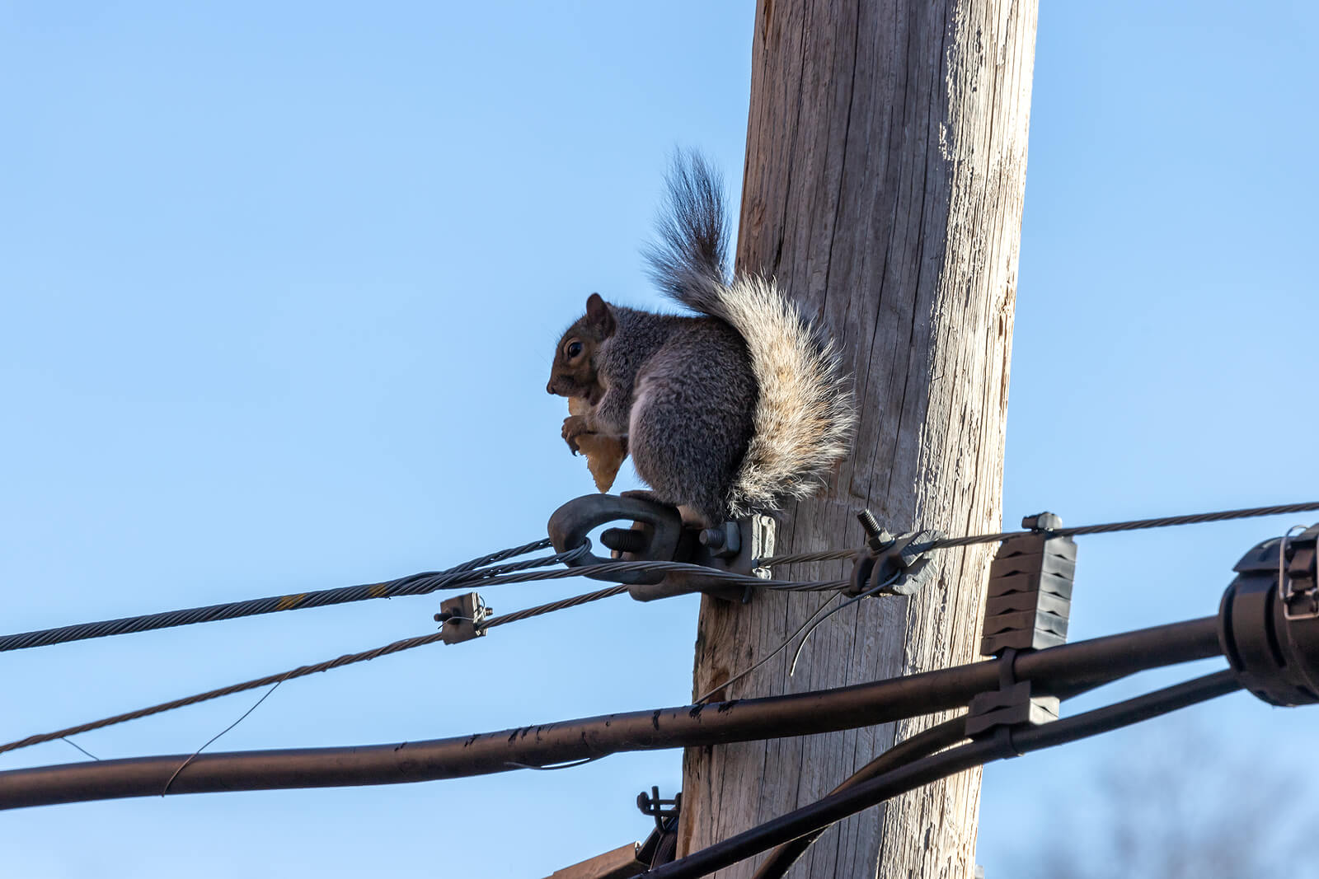
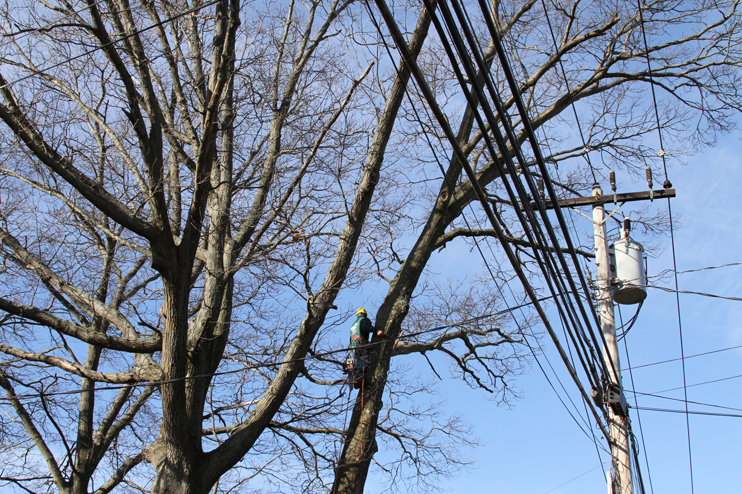
Power Outage risk interconnection - relationship with social and environmental critical risk indicators
OLUKUNLE OWOLABI – PhD Mechanical Engineering
SAIDI $=\frac{\begin{aligned} \\ NUMBER OF CUSTOMERS AFFECTED X DURATION\end{aligned}}{NUMBER OF CUSTOMERS SERVED}$

Slide 8
Social and Personal Identity Exploration of
White, Heterosexual, Cisgender Young Adults in the U.S.
Profiles of Racial, Sexual Orientation, and Gender Identity Exploration
Social Identity Profiles
& Personal Identity Exploration
Yerin Park, Department of Child Study and Human Development, Tufts University

Slide 9
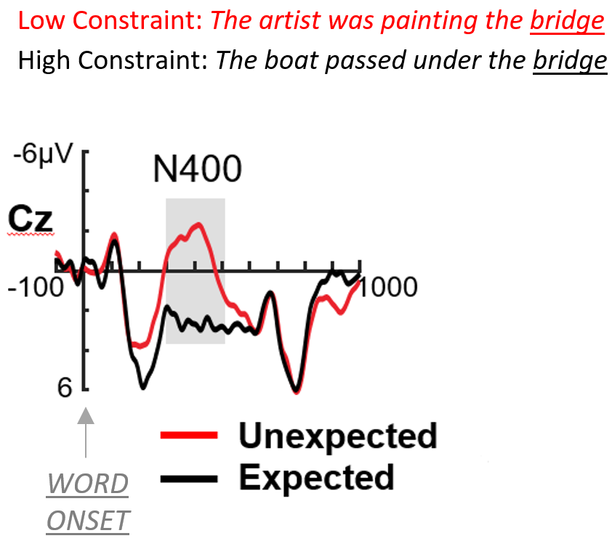
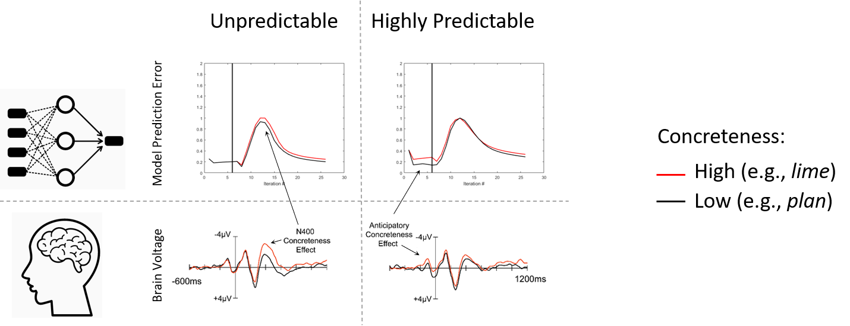
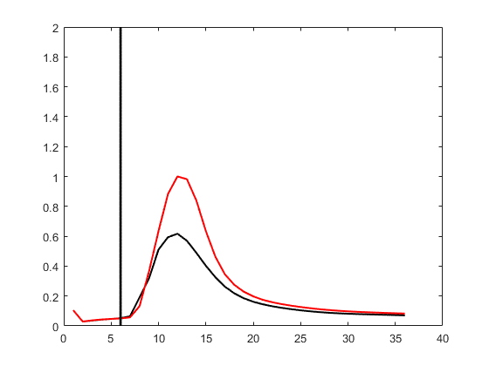
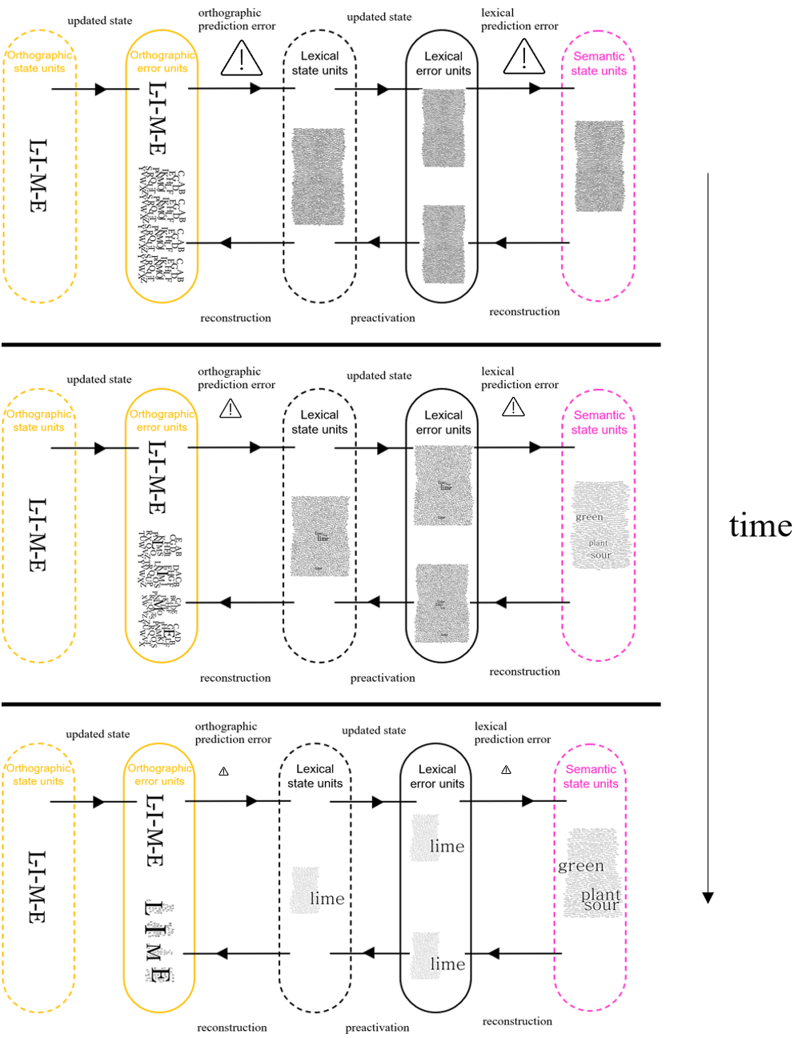
REMnet: A Predictive Coding Model for Word Comprehension
Samer Nour Eddine, MD
NeuroCognition of Language Lab
Dept. of Psychology
Tufts University

Slide 10
Power Outage risk interconnection - relationship with social and environmental critical risk indicators
OLUKUNLE OWOLABI – PhD Mechanical Engineering
SAIDI $=\frac{\begin{aligned} \\ NUMBER OF CUSTOMERS AFFECTED X DURATION\end{aligned}}{NUMBER OF CUSTOMERS SERVED}$

Slide 11

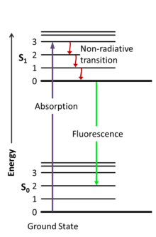
Fluorescence Nanoparticles for Cancer Diagnosis
Mahshid Iraniparast
Advisor: Prof. Igor Sokolov
Mechanical Engineering
Tufts University
Fluorescence property
Silica nanoparticles with nano-sized pores

Slide 12
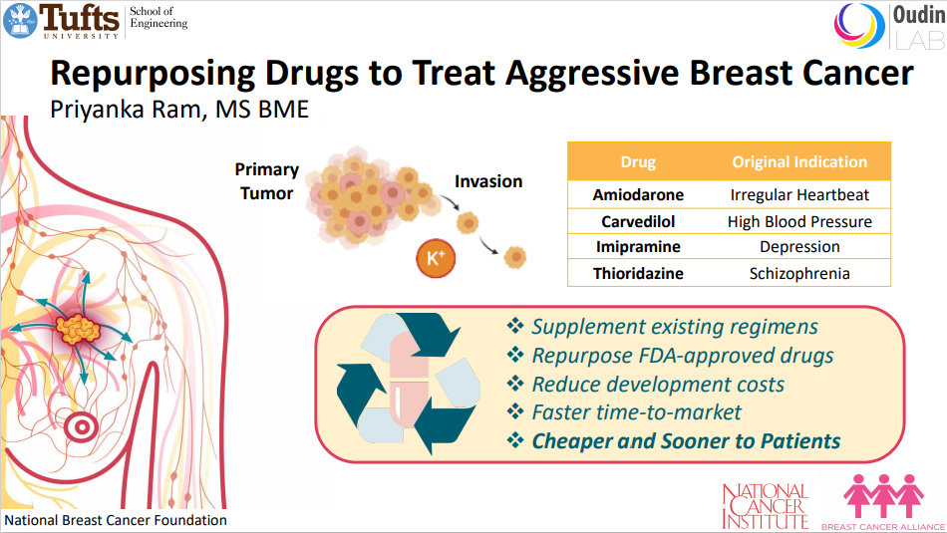

Slide 13
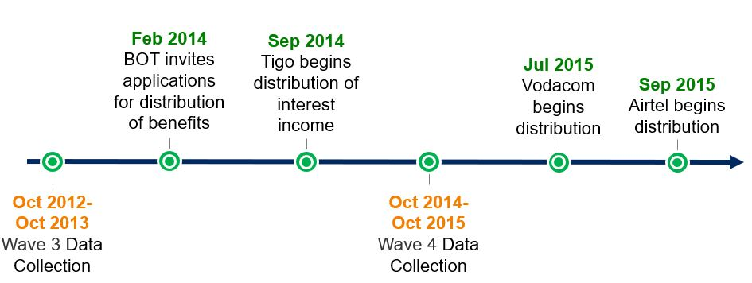
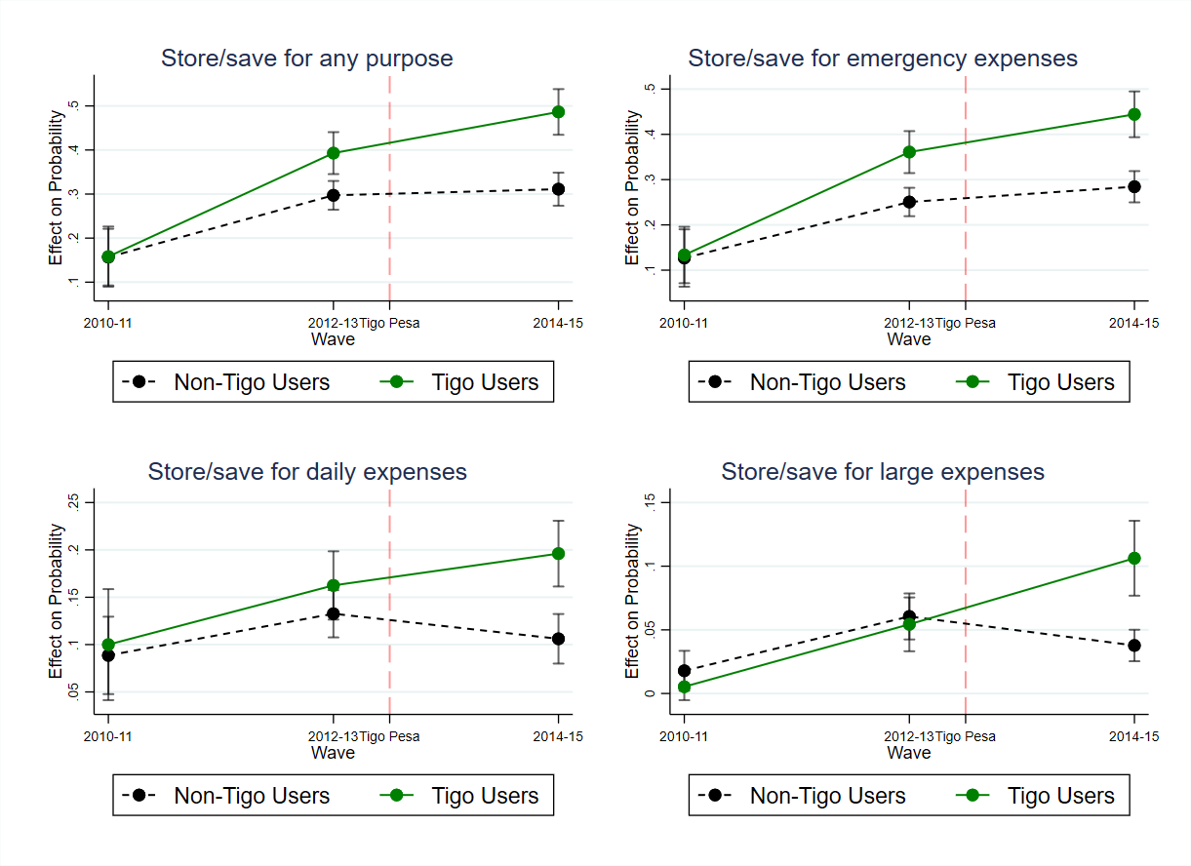
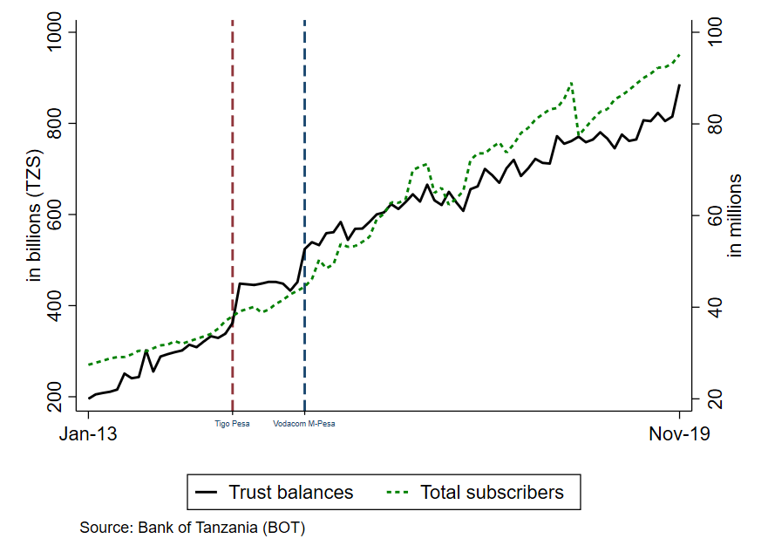
Can people use mobile money to save in Tanzania?
Girija Bahety
Ph.D. in Economics and Public Policy
Economics Department & The Fletcher School

Slide 14

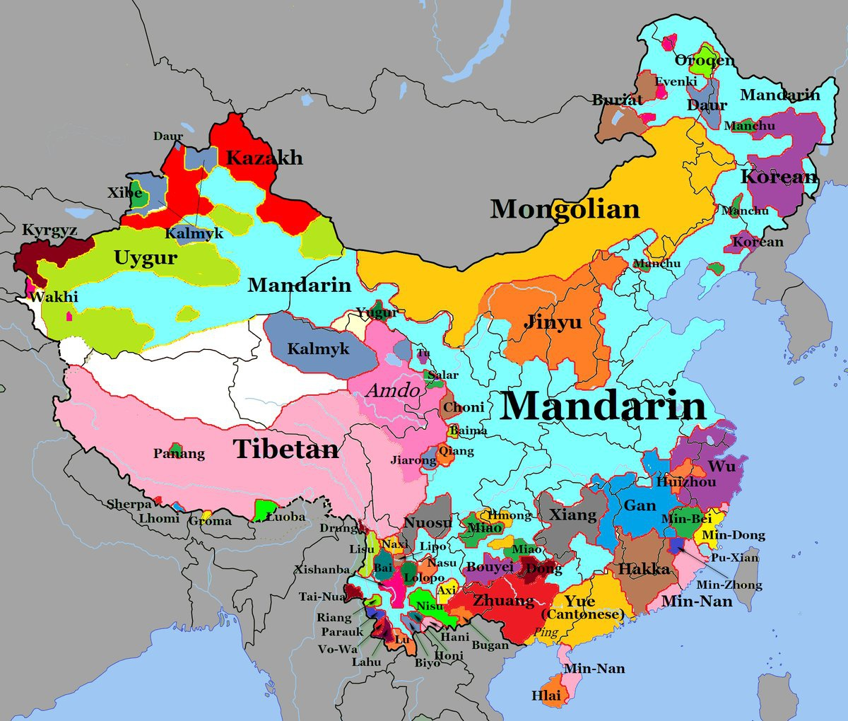
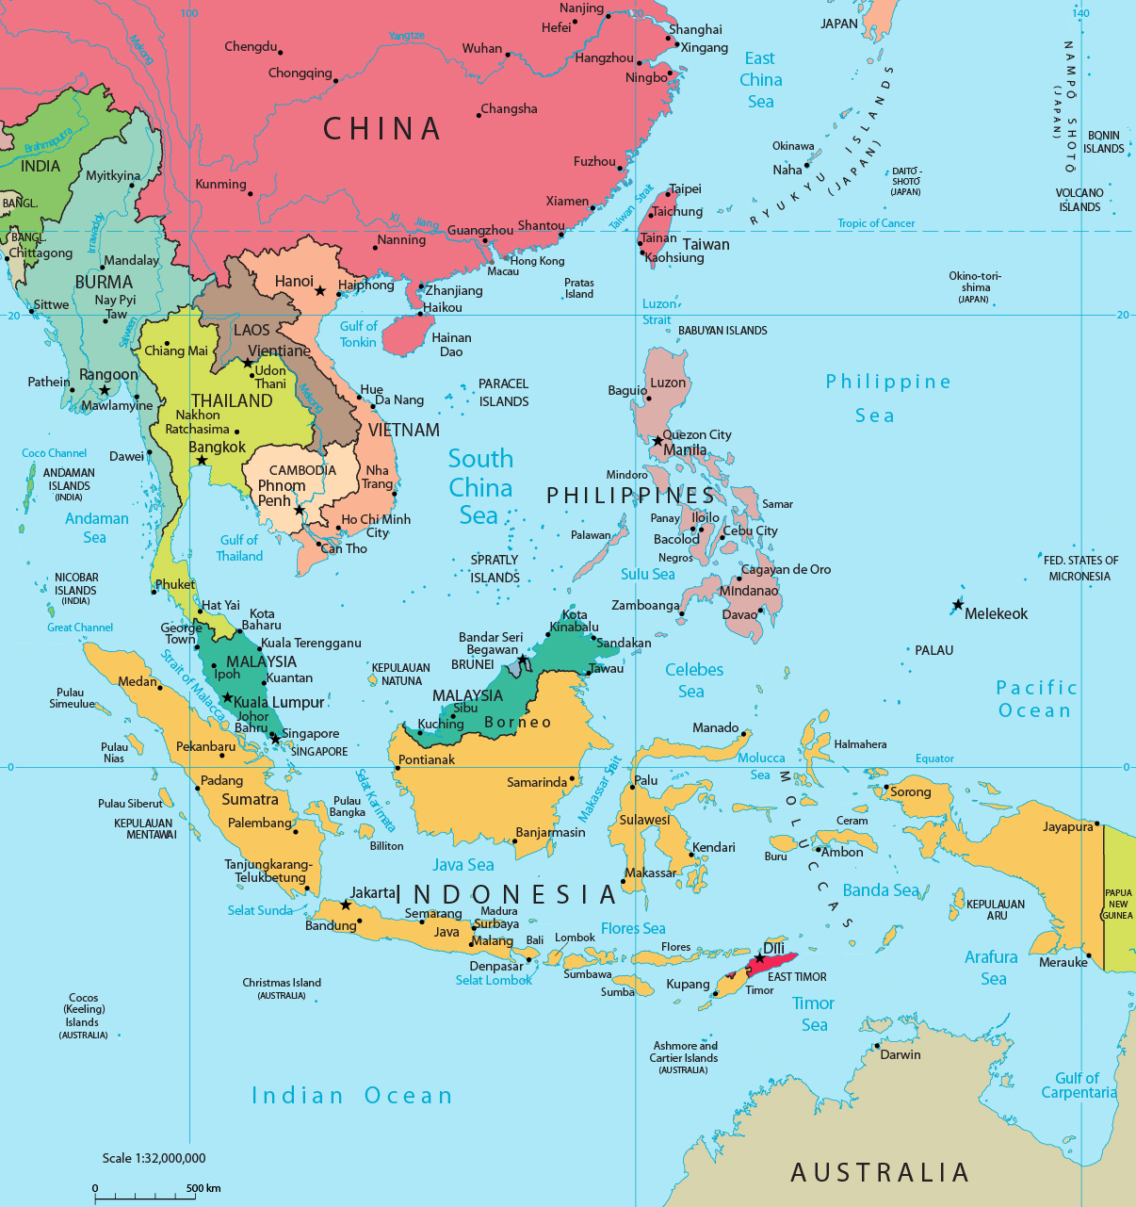
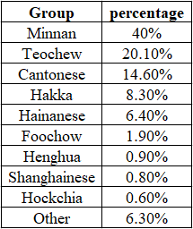
Language and Trade
Xiaoyang Ji

Slide 15
How Emergent Adults Represent Parent Voice and Roles in Their Narratives of Salient Experiences and Transitions
“Emergent Adults” -the target participants 18-25 years old
“Parent”- the study is situated in a specific social context
“Voices and Roles”- the central construct of the present study
“Narratives” -a narrative approach; written life stories will be collected
“How”, “Represent”: a qualitative study; from a participant’s view; meaning making
YiFan Zuo

Slide 16
Thank you for coming to Tufts 3MT 2020!
Awards will be announced soon.
This event is sponsored by the Dean’s offices in GSAS and SoE and AS&E Graduate Student Council

